Slide 1
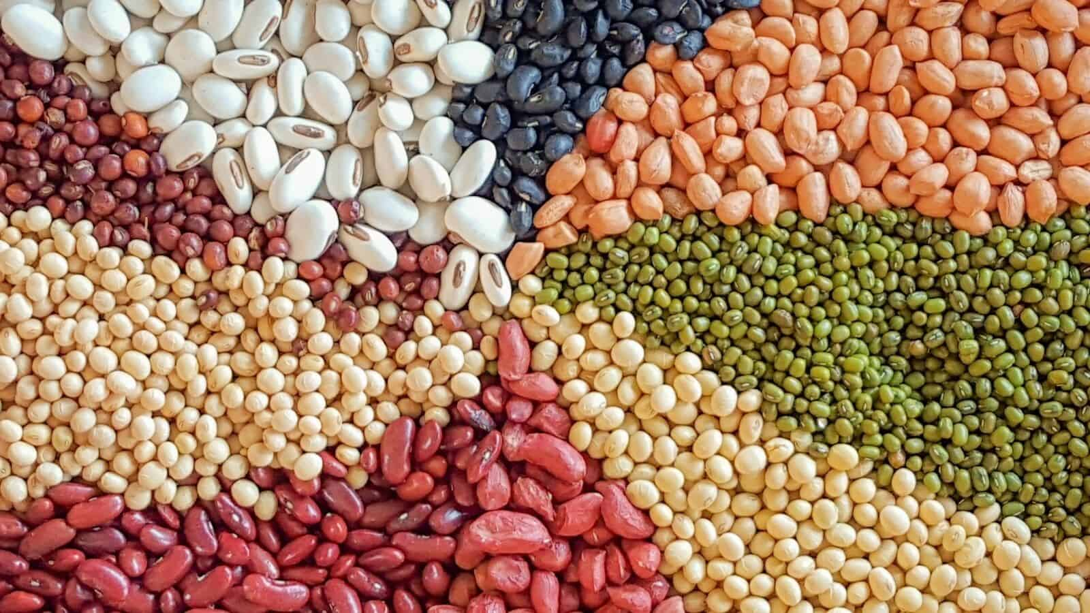
Early-stage trait discovery in pulses
Prof Lars Østergaard

Slide 2
Why Pulse crops?
Release less GHGs per unit area than other foods
Require less input (fix atmospheric N₂, C sequestration)
Regenerate nutrient-deficient soils (ideal for crop rotation)
World-wide source of high-quality food
Benefit to human health
- High in protein, minerals, vitamins and resistant starch

Slide 3
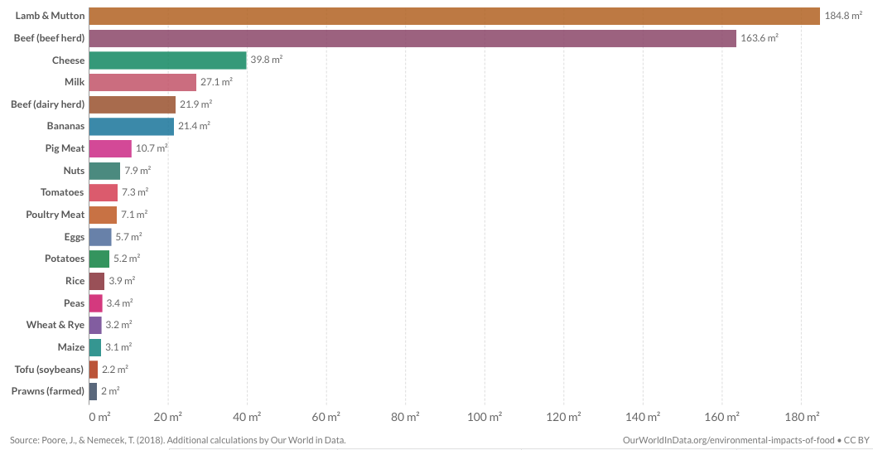
Healthy Planet
Land use per 100 g protein

Slide 4
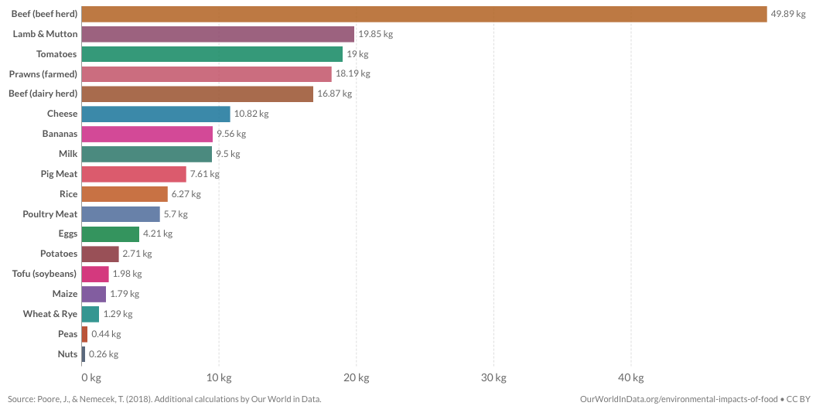
Healthy Planet
GHG emissions per 100 g protein
Greenhouse gas emissions are measured in kilograms of carbon dioxide equivalents (kg CO₂ eq).

Slide 5
Healthy People

Slide 6
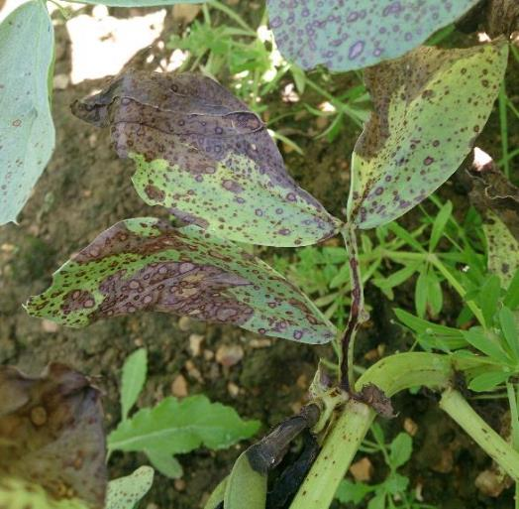
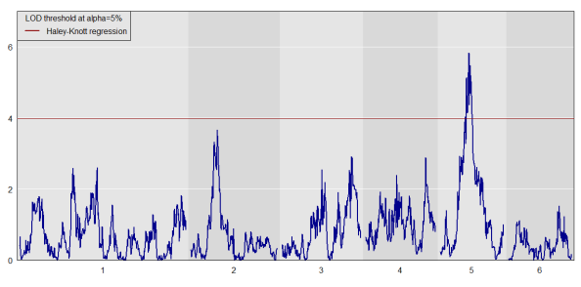
Healthy Plants
A model for pre-breeding research
Chocolate spot in Faba
QTL scan for Chocolate spot scored in the field
Tom Wood
Jane Thomas
NIAB has:
1) identified improved resistance in Faba germplasm
2) created genetic tools to track the resistance in breeding programmes 3) generated early-stage material for use by plant breeders

Slide 7
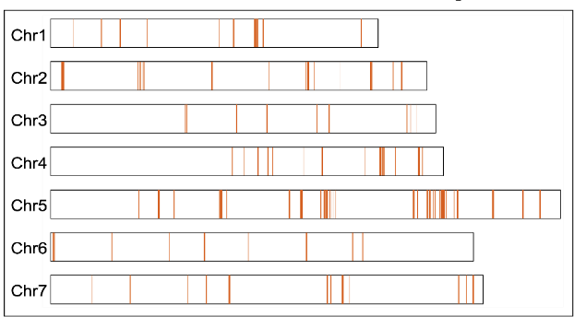
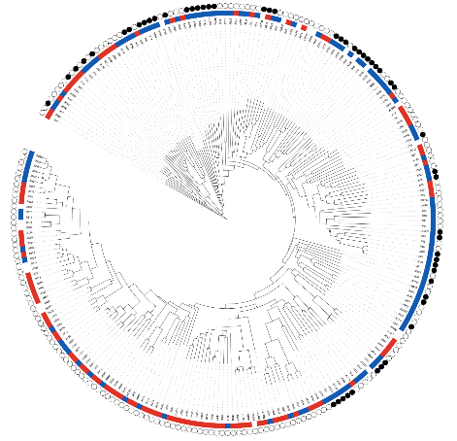
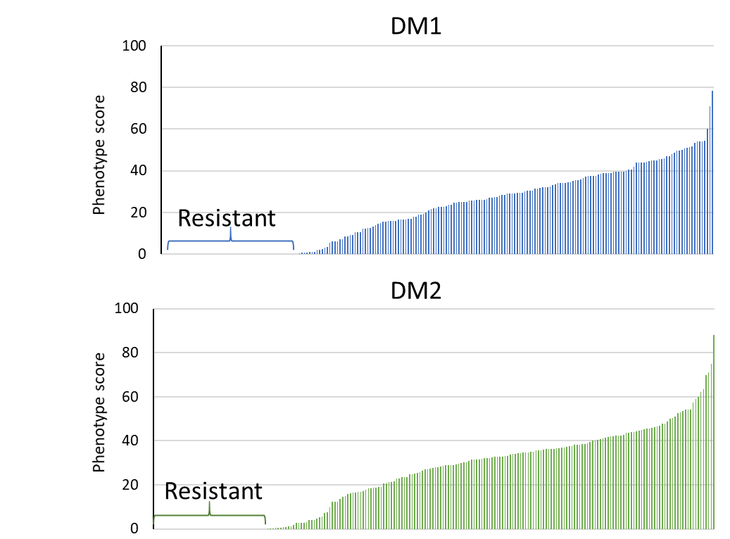
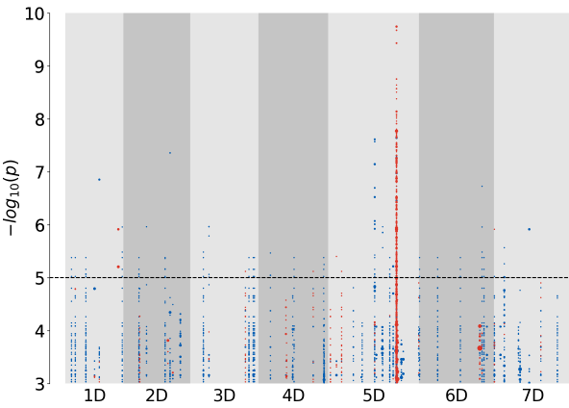
Healthy Plants
Map of NLR resistance genes in pea genome
Sanu Arora
JIC
Resistance diversity
towards Downy Mildew
in pea lines with 2 UK isolates
Genome-wide association study
1 2 3 4 5 6 7
Chromosome number

Slide 8
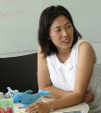
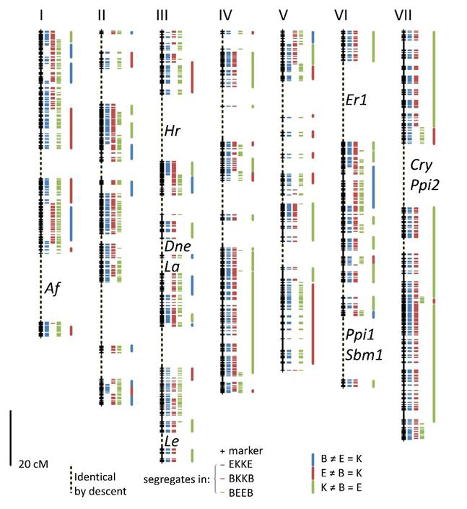
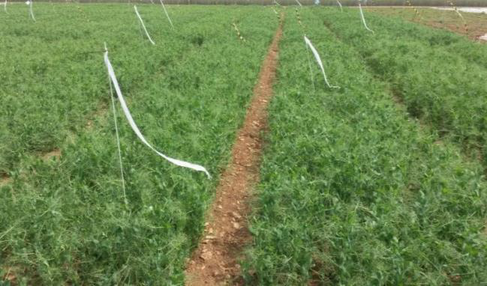
Genetic determinants of seed traits and yield
Engima
Chia Hattori
Mean seed
weight
Brutus
Kahuna
Noel Ellis

Slide 9
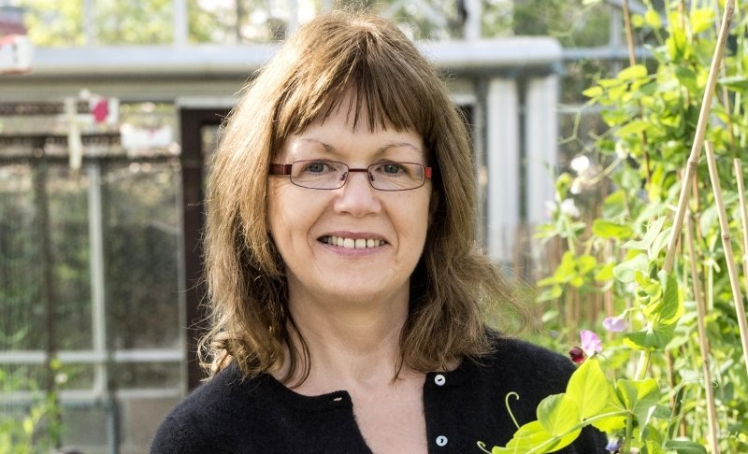
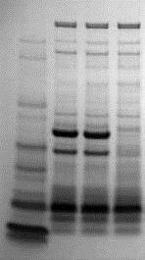
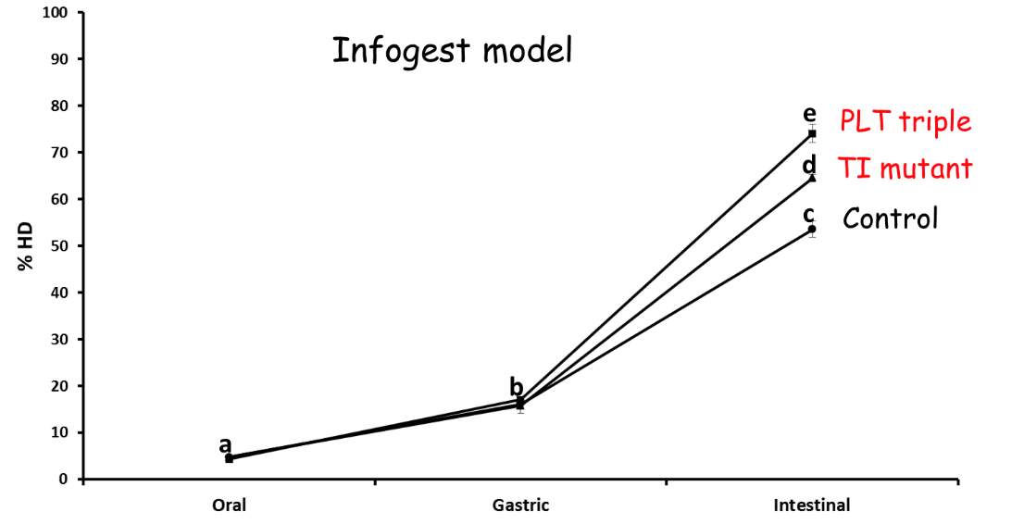
Modifying digestibility of pea seed protein
TI mutant
Claire Domoney
Control
PLT triple
Tracy Rayner
Infogest model
PLT triple
TI mutant
Control
PA2
LecA
Oral
Gastric
Intestinal

Slide 10
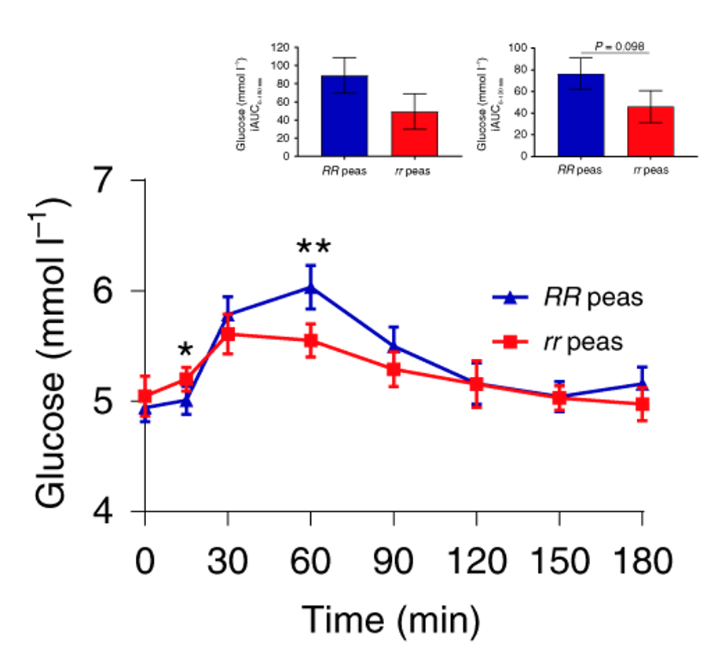
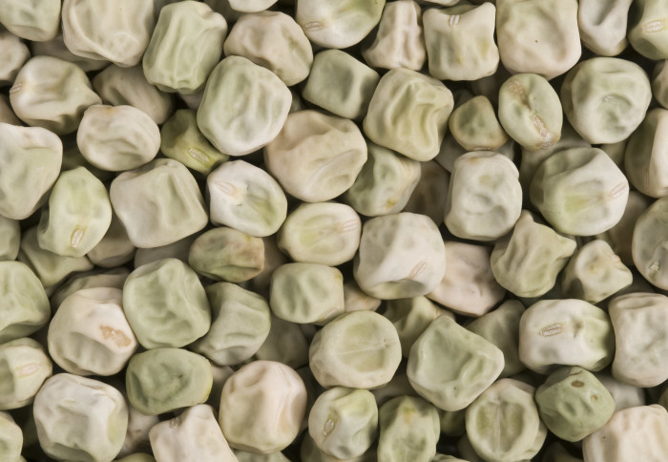
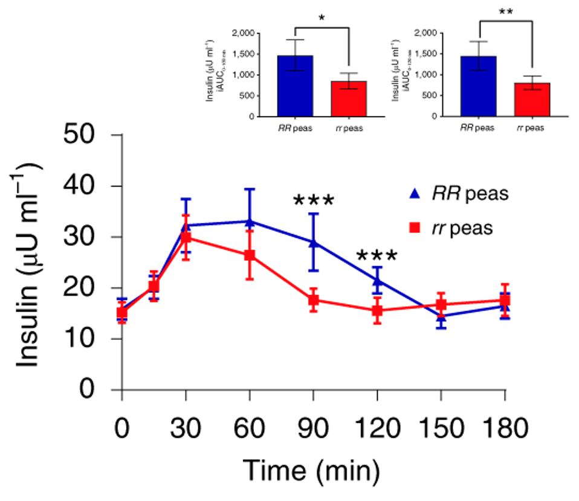
Lowering blood sugar with resistant starch
Claire Domoney
Human intervention study:
rr genotype of pea led to a
lower glycaemic and insulaemic
response than RR genotype.
Wrinkled ’super’ pea
Implication for the design of
health-promoting foods and
reducing risk of type 2 diabetes.
Petropoulou et al (2020) Nature Food 1:1-12

Slide 11
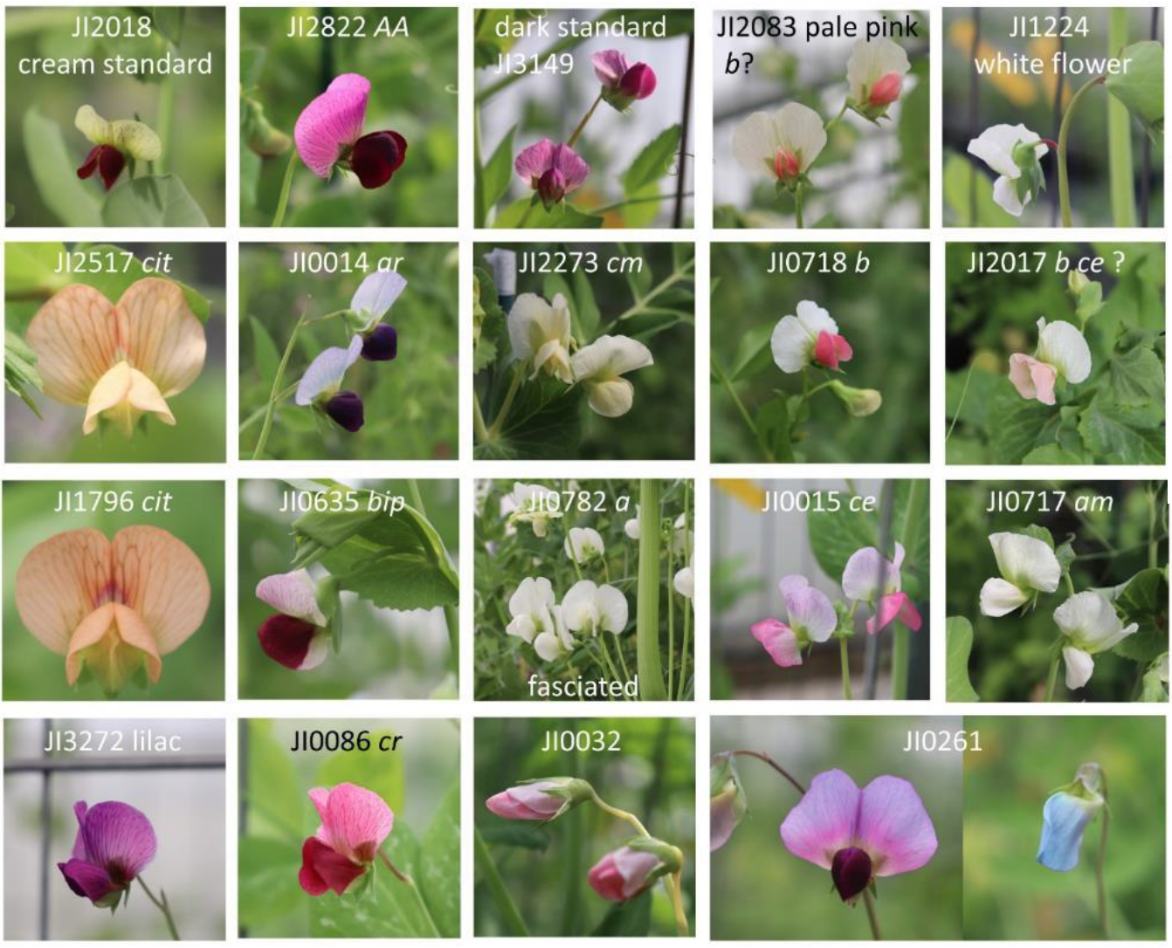
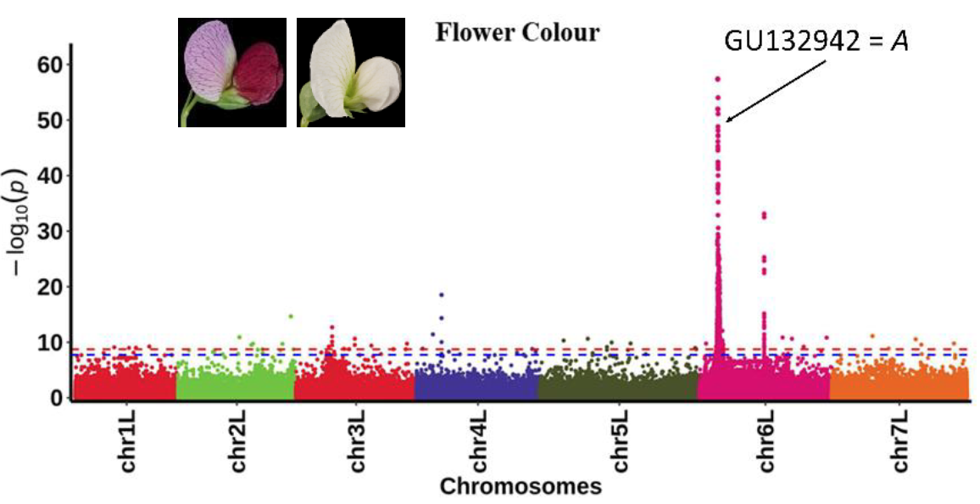
Tools and Resource development
Mendel-Seq: JIC collaborative genomics programme on pea with AGIS, China
- Genome sequence (x20) of >700 accessions
Noam Chayut
JIC GRU
Shifeng Cheng
AGIS
Noel Ellis
JIC

Slide 12
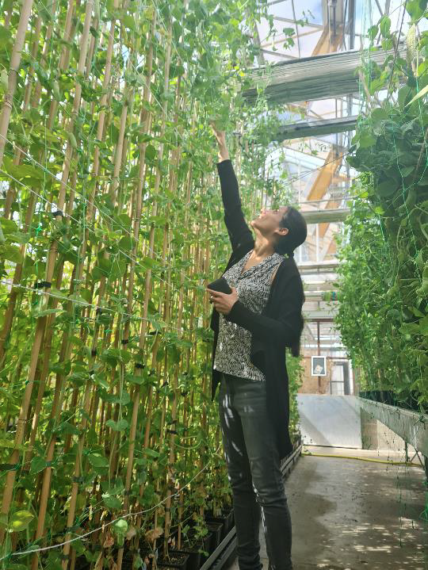
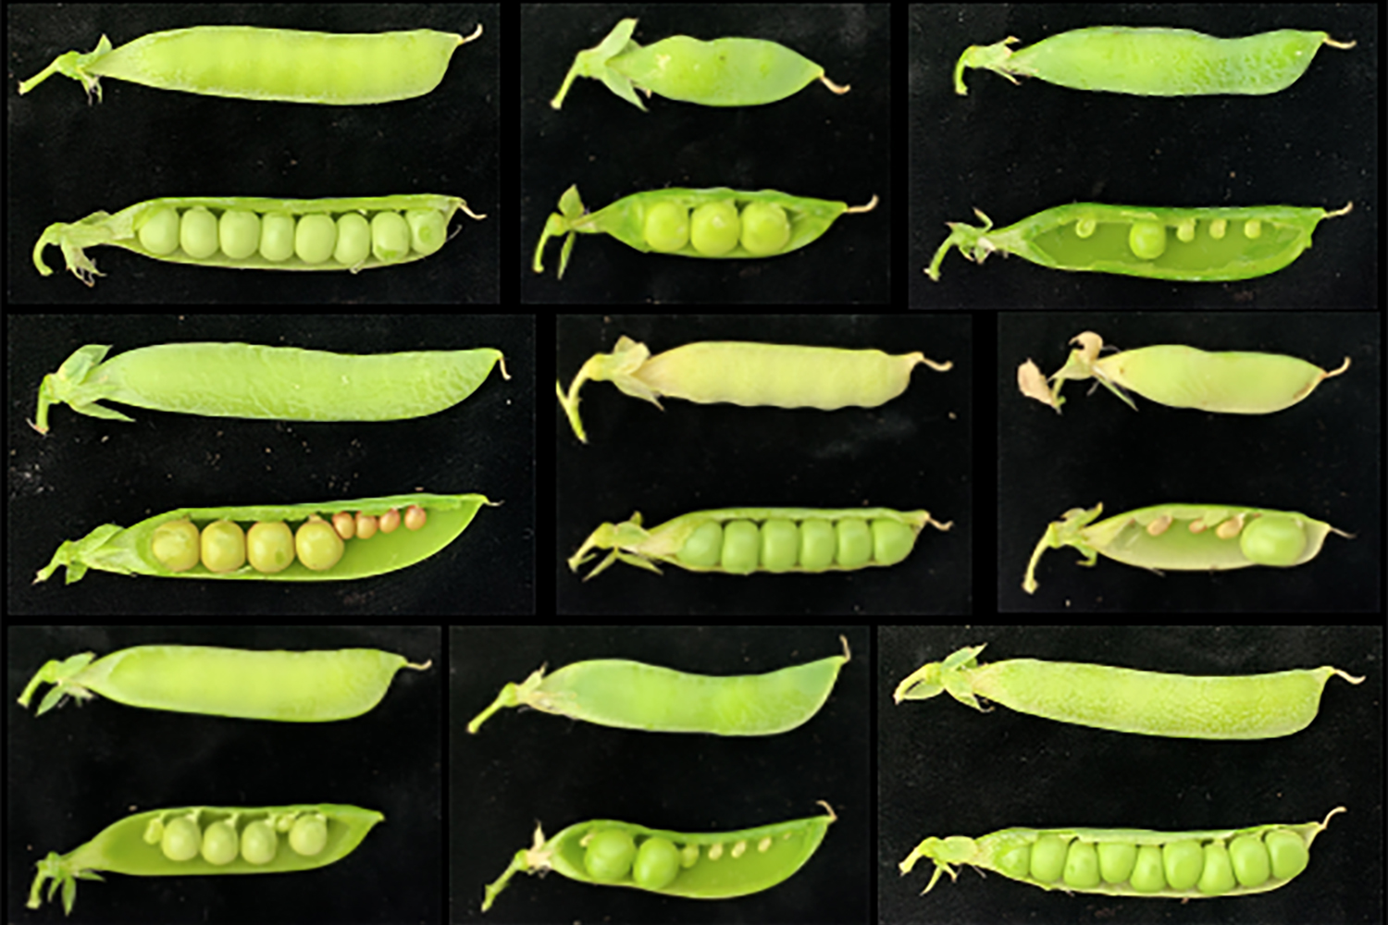
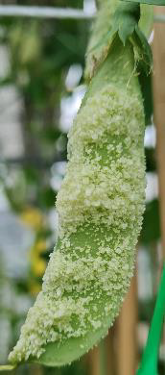
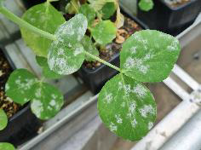
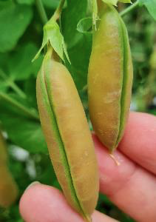
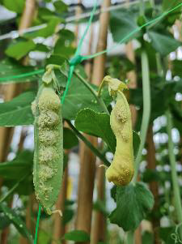
Tools and Resource development
Examples of trait diversity in the Mendel-Seq population

Slide 13
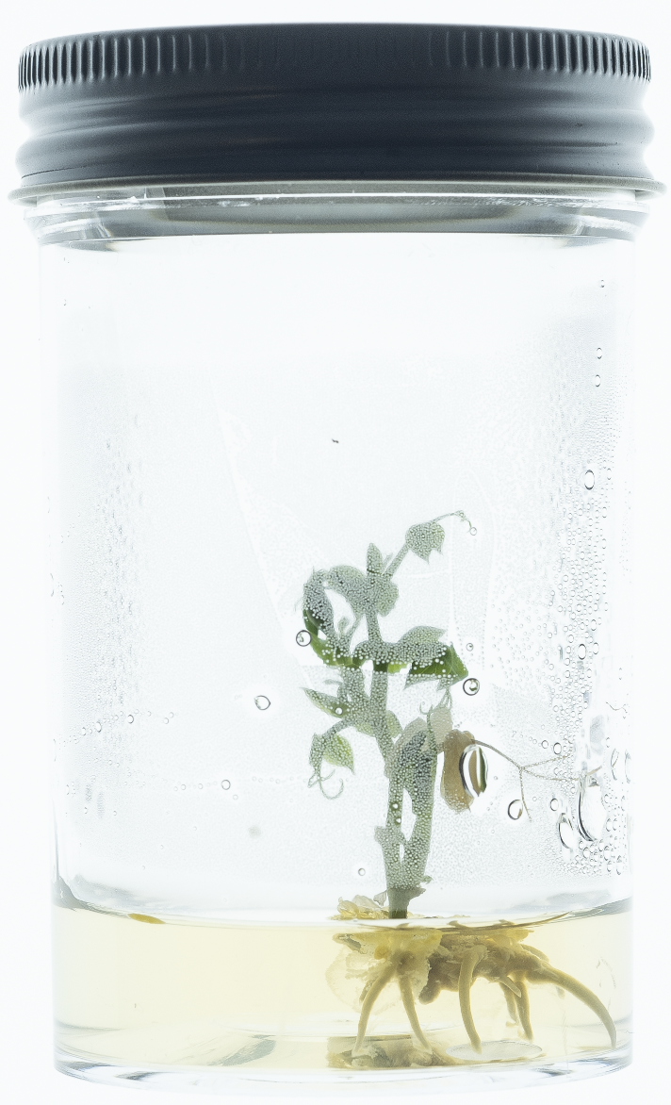
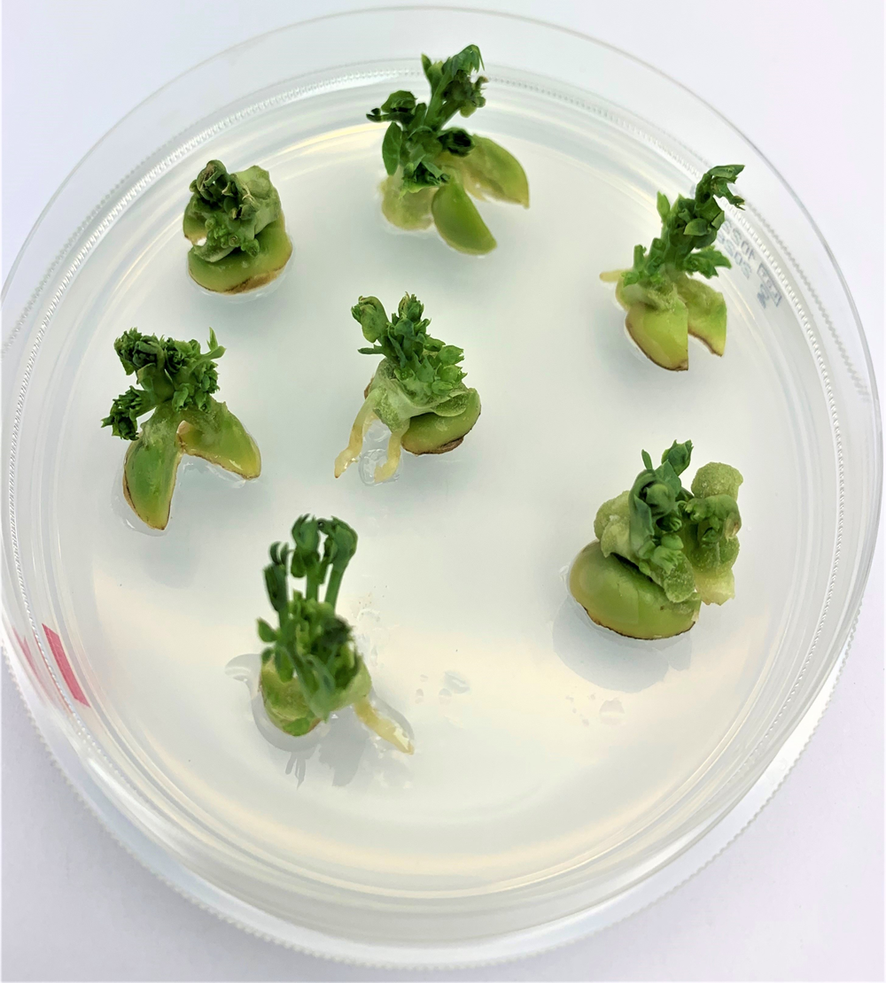
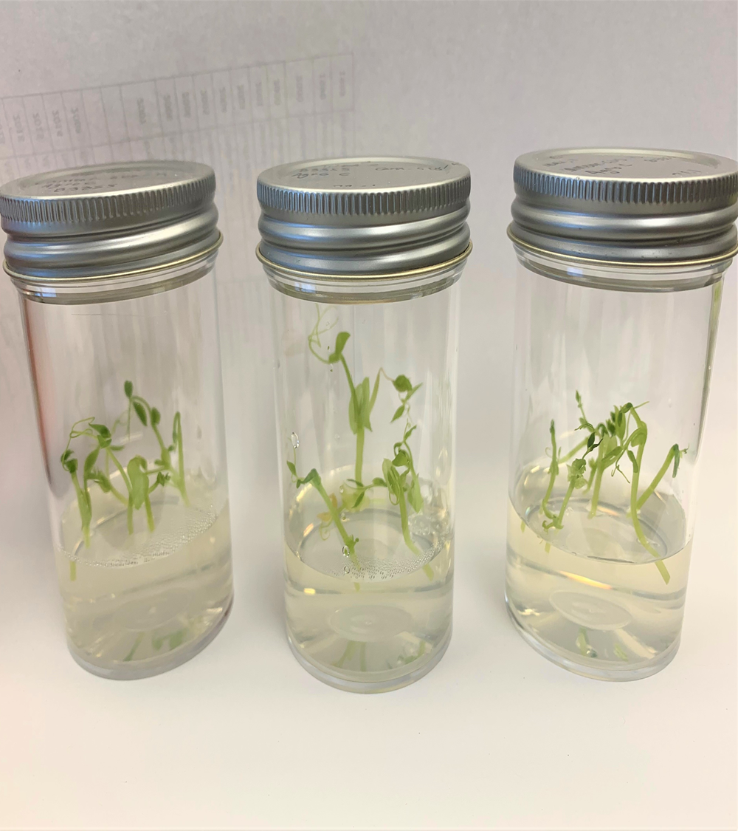
Tools and Resource development
High-quality Genome sequencing and annotation
Burkhard
Steuernagel
JIC
Pulse crop transformation and gene editing
Monika Chhetry
Emma Wallington

Slide 14
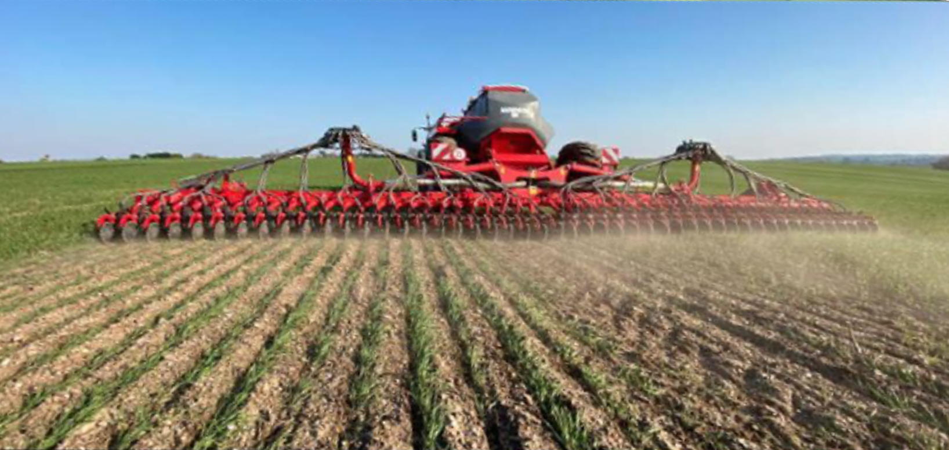
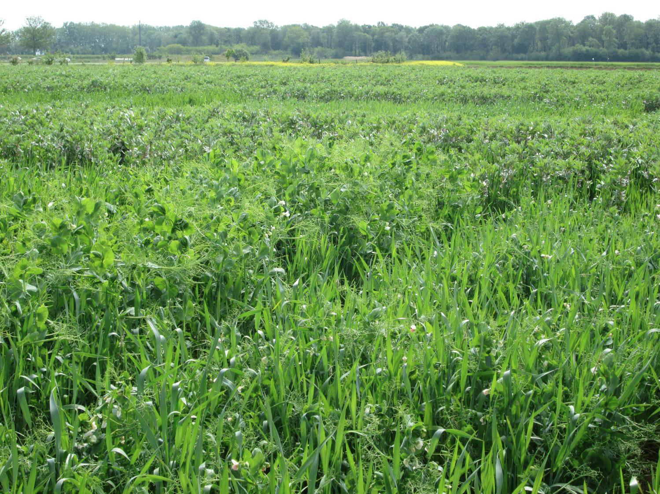
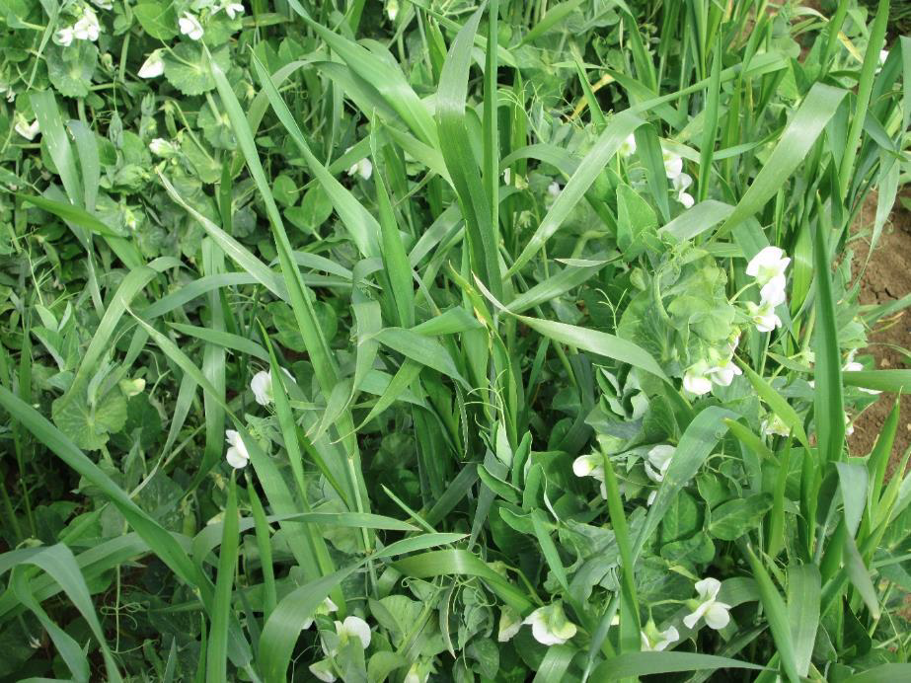
Need to reduce use of nitrogen fertiliser
Immediate term:
Current shortage of nitrogen fertiliser within the UK and the massive impact on prices dominates discussion in farming circles.
Finding other sources of nitrogen – preferably those that benefit soil and make contributions to sustainable farming systems – is a priority for farmers looking to reduce input.
Jan 2022 prices increased 2.5-3 times compared to Jan 2021 (e.g. from £287/tonne to £758/tonne for Granular urea). Now >£1,000/tonne
=> low-input agriculture

